Slide 1
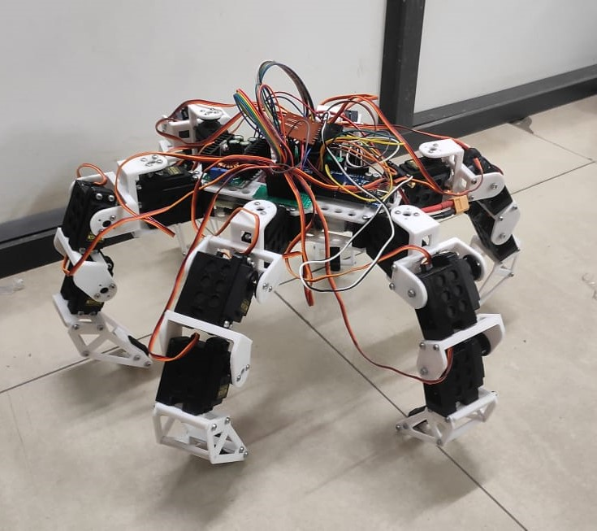

Hexapod Robot
A hexapod robot is a six-legged robotic system designed for various purposes. It combines advanced design, mechanics, sensing, and control to achieve versatile movement capabilities.

Slide 2
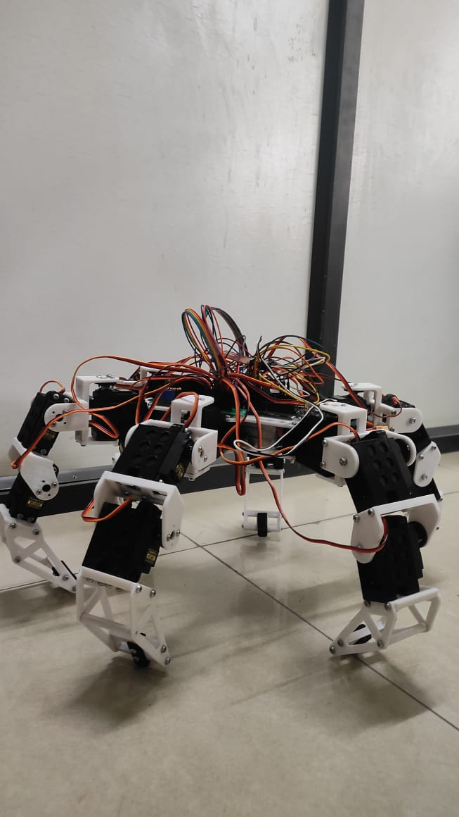
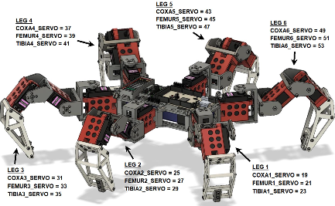
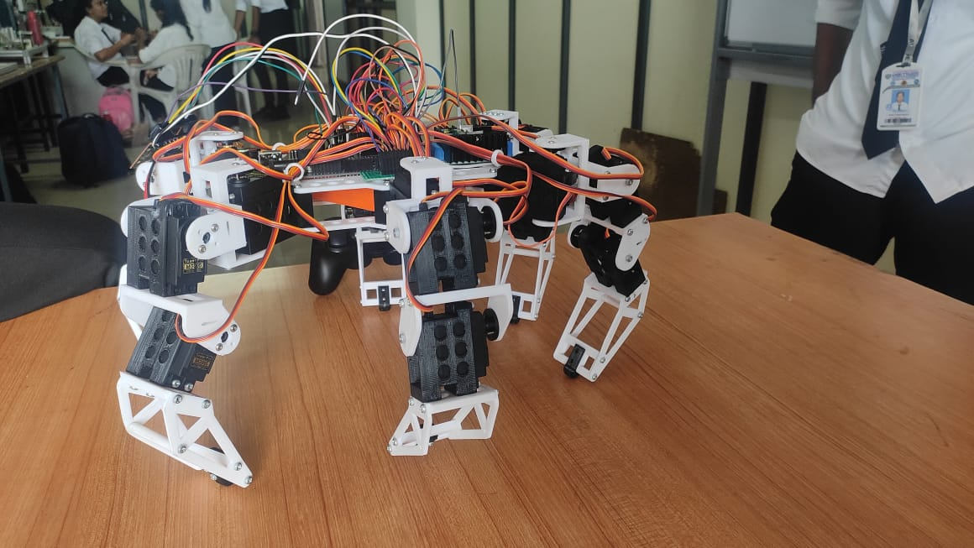
Design and Mechanics
Structure
Components
Movement Capabilities
The hexapod robot consists of a sturdy body with six legs, mimicking the movement of insects. Each leg consists of multiple joints, enabling precise control and adaptability.
The robot is equipped with powerful servo motors, sensors, and microcontrollers. These components work together to achieve smooth and coordinated leg movements.
Hexapod robots have the advantage of high stability, agility, and the ability to navigate through challenging terrains such as uneven surfaces or narrow spaces.

Slide 3
Control and Navigation
1
Control Systems
Precise control systems ensure coordinated leg movements and balance. These systems work in real-time to maintain stability and achieve desired actions.
2
Navigation Algorithms
Through autonomous navigation algorithms, hexapod robots can plan and execute complex movement sequences, making them capable of exploring unknown areas or performing specific tasks.

Slide 4
Applications
Industrial Applications
Research and Development
Hexapod robots find applications in industries such as logistics, agriculture, and manufacturing. They can perform tasks like inspection, carrying heavy loads, and operating in hazardous environments.
Hexapod robots play a significant role in research areas like robotics, biomechanics, and artificial intelligence. They are used to study locomotion, test algorithms, and simulate insect behavior.

Slide 5
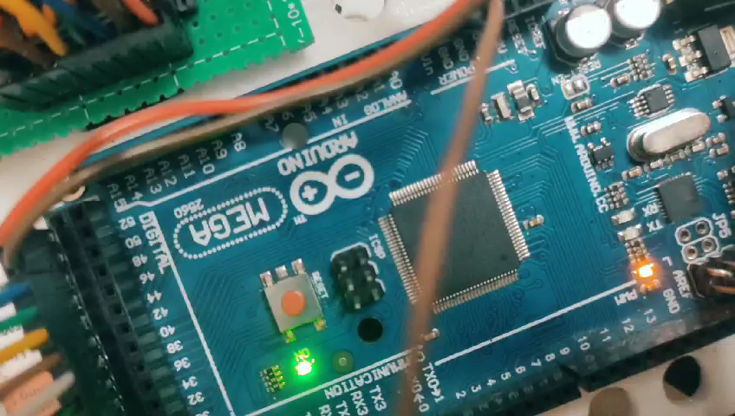
Video

Slide 6
THANK YOU

